Slide 1

Foundational Skills Program
Course Title: Software Testing
Date: April 19, 2026
Md. Golam Mostofa
AI/ML-QA Engineer, Bizzntek Ltd

Slide 2
Outline
Introducing Chatbot
Introducing RAG
Environment setup
Launch EDGE Chatbot
Test EDGE Chatbot

Slide 3
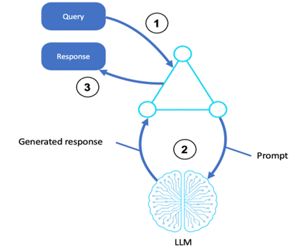
Introducing Chatbot
- A chatbot is an AI-powered software that simulates
human conversation
- It accepts user queries and generates responses
using a Large Language Model (LLM)
- Works through a 3-step process:
1. User sends a Query
2. LLM processes the Prompt
3. Chatbot returns a Generated Response
- Common use cases: customer support, education,
and information retrieval
Source: Workflow for prompt chaining - AWS Prescriptive Guidance

Slide 4
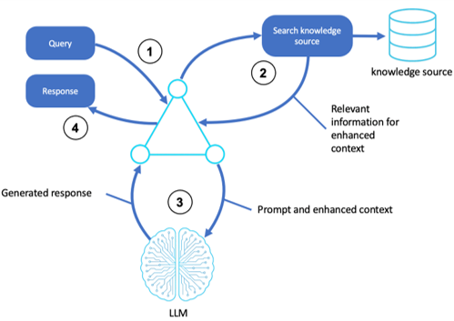
Introducing RAG
Introducing RAG (Retrieval-Augmented Generation)
- RAG enhances a chatbot by connecting it to an
external knowledge source
- Overcomes LLM limitations like outdated or
missing information
- Works through a 4-step process:
1. User sends a Query
2. System searches the Knowledge Source
3. Relevant information is retrieved for context
4. LLM generates a Response using enhanced context
- Improves accuracy, relevance, and trustworthiness
of chatbot responses
- Used in the EDGE Chatbot to answer questions from
the EDGE Bangladesh knowledge base
Source: Workflow for prompt chaining - AWS Prescriptive Guidance

Slide 5
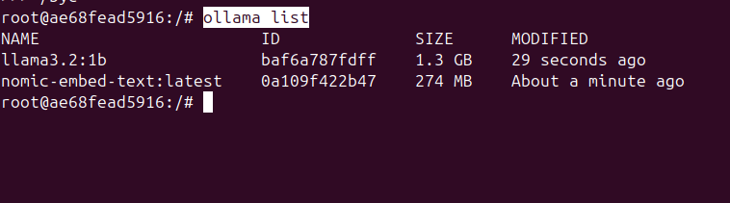
Environment Setup (Pre-requisites)
Pre-requisites
Ollama install
Llama3.2:1b
Nomic-embed-text

Slide 6
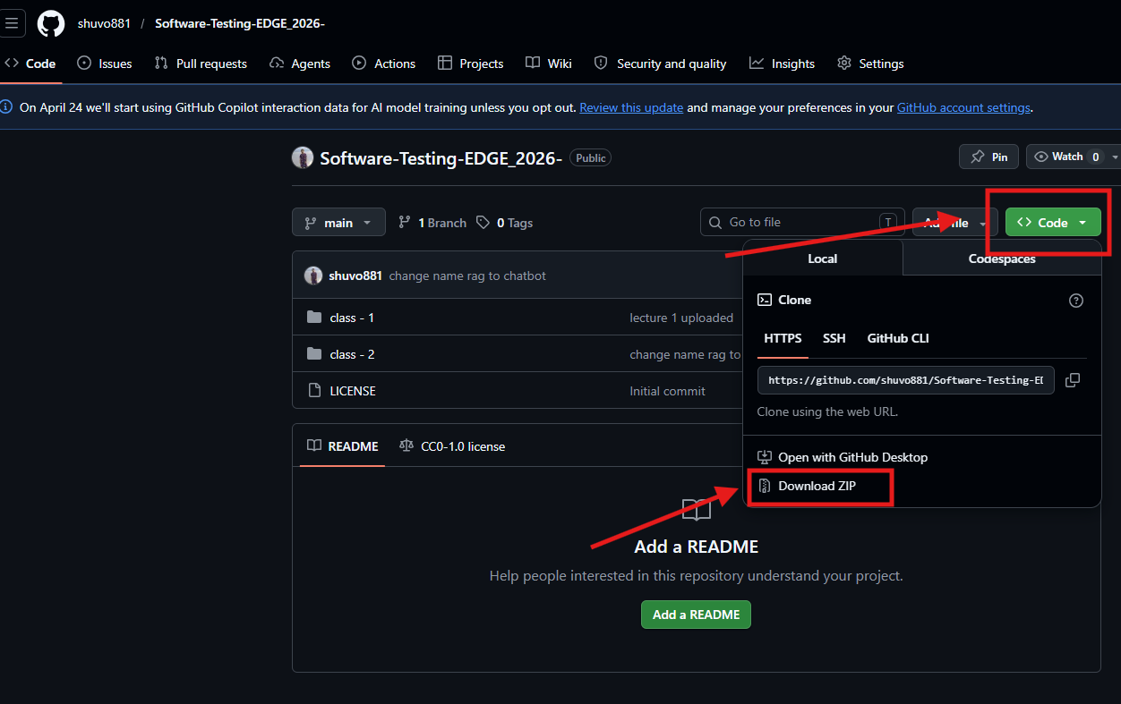
Environment Setup (Repository)
Goto repository: Software-Testing-EDGE 2026
Download the Repository

Slide 7
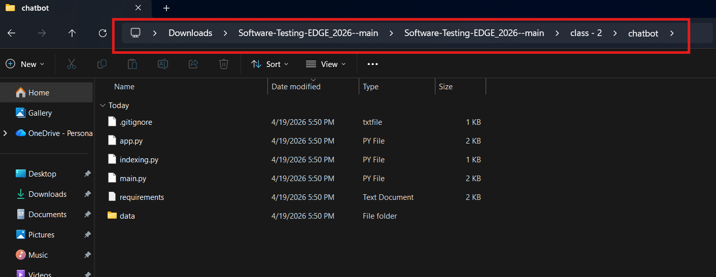
Environment Setup (Unzip)
Unzip the 'Software-Testing-EDGE_2026—main'
Go to: Chatbot folder

Slide 8
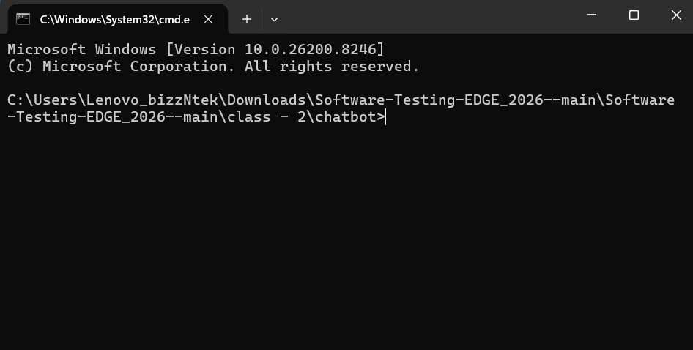
Environment Setup (Command Prompt)
Open Command Prompt

Slide 9
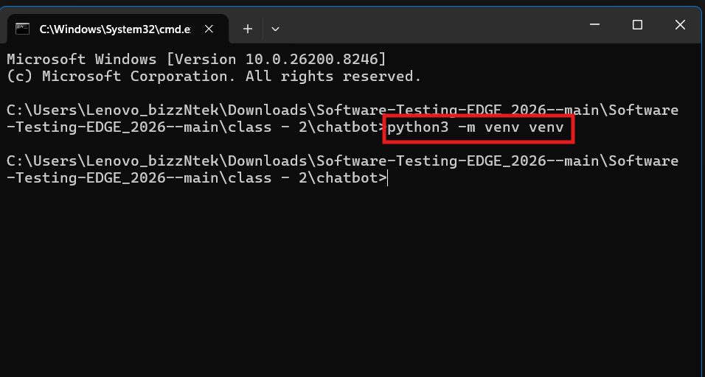
Environment Setup (Virtual Environment)
Create Virtual Environment 'python3 –m venv venv'

Slide 10
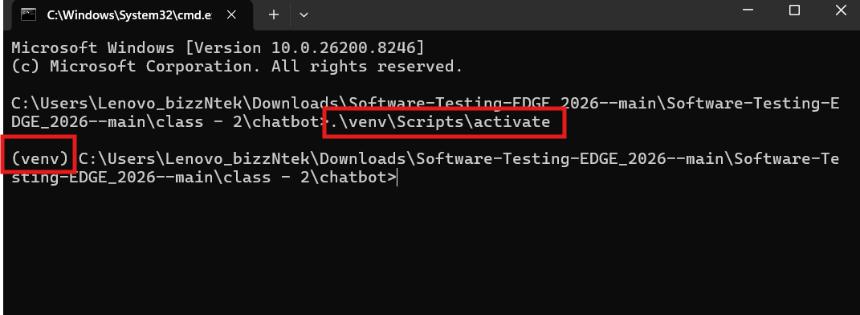
Environment Setup (Activate)
Active Virtual Environment '.\venv\Scripts\activate'

Slide 11
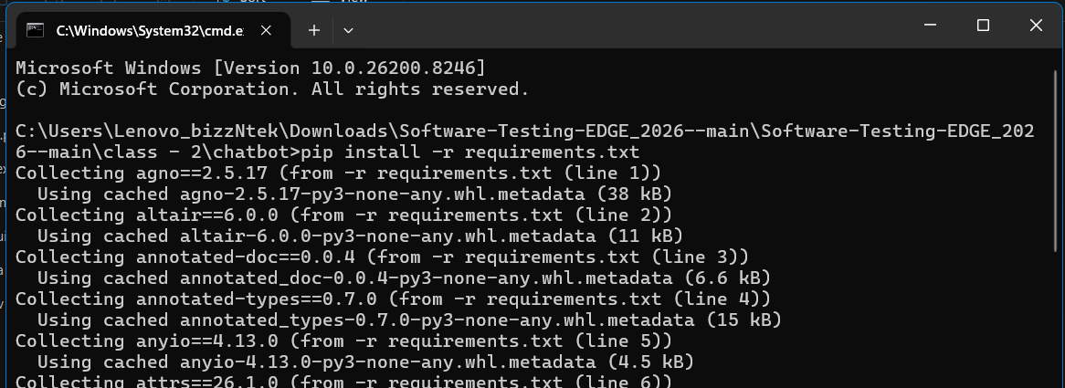
Environment Setup (Install)
Install Dependencies 'pip install -r requirements.txt'

Slide 12
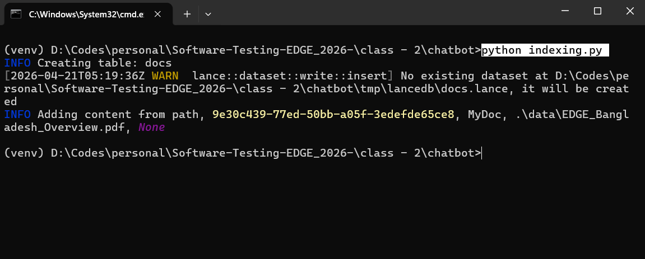
Environment Setup (Run)
Add knowledge into Database 'python indexing.py'

Slide 13
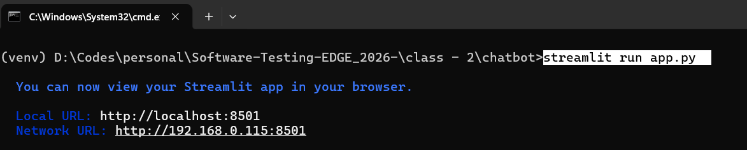
Environment Setup (Run)
Run the Chatbot app 'streamlit run app.py'

Slide 14
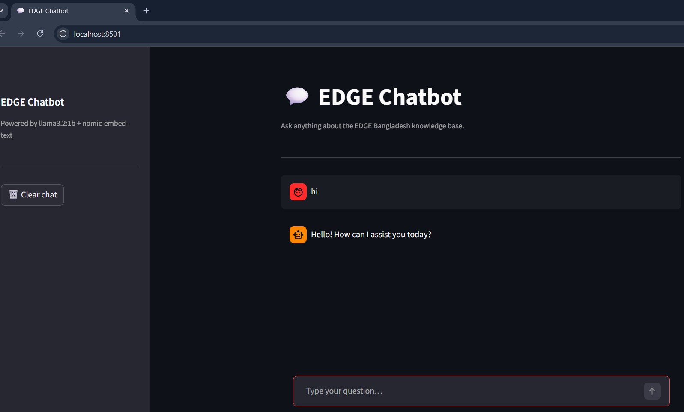
Launch EDGE Chatbot
Open your browser
Goto: 'http://localhost:8501/'

Slide 15
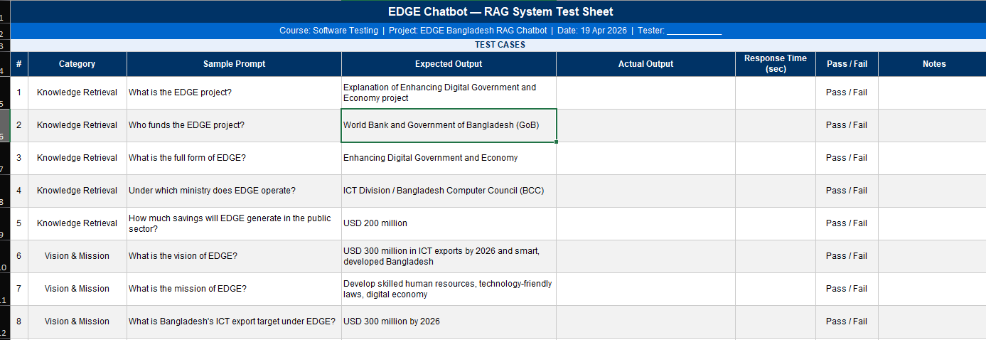
Test EDGE Chatbot
Test Sheet: EDGE_Chatbot_Test_Sheet.xlsx

Slide 16
Q&A
Any Questions?

Slide 17
Thanks
Md. Golam Mostofa
golam.mostofa@bizzntek.com

